Slide 1
Presentation about colormap,reshap,cat,shiftdim,……
Prepared by:
Hamouda Ahmed Osman
Section:1
Supervisor:
Dr:Khaled

Slide 2
My presentation is a bout:
Explanation the following Orders:
Colormap Jet hsv gray
Cat
Reshape
Shiftdim
Squeeze

Slide 3
Colormap
A colormap is an m-by-3 matrix of real numbers between 0.0 and 1.0. Each row is an RGB vector that defines one color. The kth row of the colormap defines the kth color, where map(k,:) = [r(k) g(k) b(k)]) specifies the intensity of red, green, and blue.
Retrieve the colormap of the figure the value are in the range 0 and 1
And retrieve matrix its columns is 3 and have any numbers of rows.
Colormap(default) sets the current figure's colormap to
the root's default, whose setting is JET.
“X=colormap” retrieve the current colormap

Slide 4
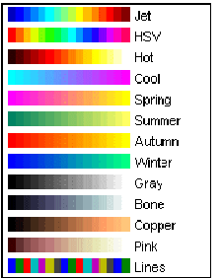
Specifying the colormap
colormap(bone(128))
creates an bone colormap with 128 colors. If you do not specify a size, MATLAB creates a colormap the same size as the current colormap.

Slide 5
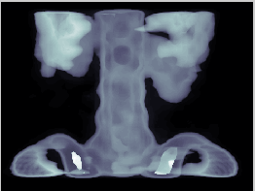
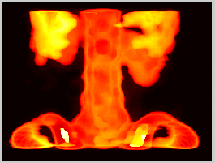
Example
>>load spine
image(X)
colormap bone
>>load spine
image(X)
colormap hot

Slide 6
bone is a grayscale colormap with a higher value for the blue component. This colormap is useful for adding an "electronic" look to grayscale images.
hot varies smoothly from black through shades of red, orange, and yellow, to white.

Slide 7
Jet
Jet(M)
is an M-by-3 matrix containing
the default colormap used by CONTOUR, SURF and PCOLOR.
The colors begin with dark blue, range through shades of
blue, cyan, green, yellow and red, and end with dark red.
JET, by itself, is the same length as the current figure's
colormap. If no figure exists, MATLAB creates one.

Slide 8
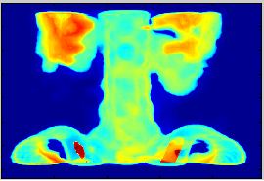
Example for Jet
Jet(3) return 3-by-3 matrix each row define one color
load spine
image(X)
colormap(jet)

Slide 9
Hsv
HSV(M) returns an M-by-3 matrix containing an HSV colormap.
An HSV colormap varies the hue component of the hue-saturation-value color model. The colors begin with red, pass through yellow, green,yan, blue, magenta, and return to red.

Slide 10
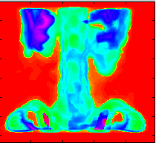
Example for Hsv
load spine
image(X)
colormap(hsv)

Slide 11
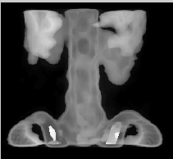
Gary
Linear gray-scale color map
GRAY(M) returns an M-by-3 matrix containing a gray-scale colormap.
Example
load spine
image(X)
colormap(gray)

Slide 12
Comparison
colormap(gray) colormap(jet) colormap(hsv)

Slide 13
Squeeze
Remove singleton dimensions
B = SQUEEZE(A) returns an array B with the same elements as a but with all the singleton dimensions removed. a singleton is a dimension such that size(A,dim)==1. 2-D arrays are unaffected by squeeze so that row vectors remain rows.

Slide 14
Example for squeeze
Consider the 2-by-1-by-3 array Y = rand(2,1,3). This array has a singleton column dimension
>>Y=rand(2,1,3)
Y(:,:,1) =
0.9501
0.2311
Y(:,:,2) =
0.6068
0.4860
Y(:,:,3) =
0.8913
0.7621
>>Z = squeeze(Y)
Z =
0.9501 0.6068 0.8913
0.2311 0.4860 0.7621

Slide 15
Shiftdim
SHIFTDIM Shift dimensions.
B = SHIFTDIM(X,N) shifts the dimensions of X by N. When N is positive, SHIFTDIM shifts the dimensions to the left and wraps the N leading dimensions to the end. When N is negative, SHIFTDIM shifts the dimensions to the right and pads with singletons.
Example
>>A=rand(1,1,2,3)
>>B=shiftdim(A,2)

Slide 16
A=rand(1,1,2,3)
A(:,:,1,1) =
0.9501
A(:,:,2,1) =
0.2311
A(:,:,1,2) =
0.6068
B=shiftdim(A,2)
B =
0.9501 0.6068 0.8913
0.2311 0.4860 0.7621
A(:,:,2,2) =
0.4860
A(:,:,1,3) =
0.8913
A(:,:,2,3) =
0.7621
Note N is positive

Slide 17
>>y=rand(1,1,2)
y(:,:,1) =
0.9501
y(:,:,2) =
0.2311
>> z=shiftdim(y,-2)
z(:,:,1,1,1) =
0.9501
z(:,:,1,1,2) =
0.2311
Note N is negative

Slide 18
Cat (concatenation)
CAT Concatenate arrays.
CAT(DIM,A,B) concatenates the arrays A and B along
the dimension DIM.
CAT(2,A,B) is the same as [A,B].
CAT(1,A,B) is the same as [A;B].
B = CAT(DIM,A1,A2,A3,A4,...) concatenates the input
arrays A1, A2, etc. along the dimension DIM.

Slide 19
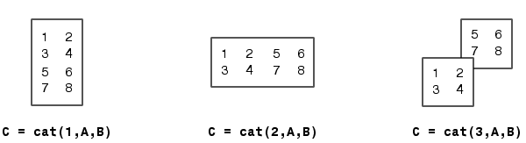
Example
A = B =
1 2 5 6
3 4 7 8
concatenating along different dimensions produces

Slide 20
Reshape
RESHAPE Change size.
RESHAPE(X,M,N) returns the M-by-N matrix whose elements are taken columnwise from X. An error results if X does not have M*N elements.
RESHAPE(X,M,N,P,...) returns an N-D array with the same elements as X but reshaped to have the size M-by-N-by-P-by-...M*N*P*... must be the same as PROD(SIZE(X)).
RESHAPE(X,[M N P ...]) is the same thing.

Slide 21
Example for reshape
Reshape a 3-by-4 matrix into a 2-by-6 matrix.
A =
1 4 7 10
2 5 8 11
3 6 9 12
B = reshape(A,2,6)
B =
1 3 5 7 9 11
2 4 6 8 10 12
B = reshape(A,2,[])
B =
1 3 5 7 9 11
2 4 6 8 10 12

Slide 22
The End

